Slide 1
JavaScript & DOM
Recitation 2
Jan 23, 2019

Slide 2
Table of Contents
JavaScript
Numbers
NaN&Infinity
Variables
Functions
Closure
Asynchronous Programming
DOM
DOM as a tree
Walking DOM
Searching DOM
Creating Elements

Slide 3
JavaScript

Slide 4
Numbers
How many number types are there in JavaScript?
Only ONE: 64-bit floating point
No integers
Examples:
X = 3
X = .33
X+=.33
How to get integers
Math.round(x)//round
Math.floor(x)//truncate

Slide 5
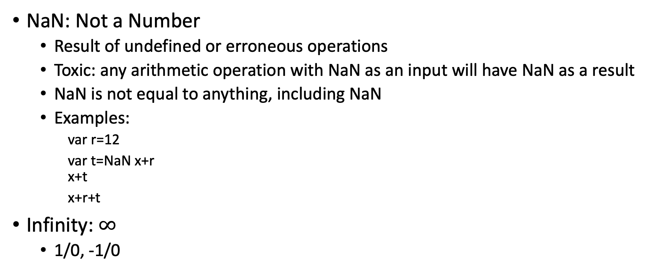
NaN and Infinity
NaN: Not a Number
Result of undefined or erroneous operations
Toxic: any arithmetic operation with NaN as an input will have NaN as a result
NaN is not equal to anything, including NaN
Examples:
var r=12
var t=NaN x+r x+t
x+r+t
Infinity: $∞$
1/0, -1/0

Slide 6
4-way to declare Variables and constants
var x = 2;
var defines a variable in the current execution context
Function context if in a function
Global context if outside a function
Does not have block scope/Oversharing in variables
let x = 2;
let defines a variable within a block scope
A block is delineated by { and }
This is the best way to define variables
const x = 2;
const defines a constant within a block scope.
Assignment is made once and only once
const PITT_ADDR = "5000 Forbes Ave" ;

Slide 7
Implicit declaration
You can just use a variable without declaring it using const, let, and var.
Example: x = 2;
Notice: all variables declared in this way will be in global
This can be bad since:
It pollutes the global namespace.
Makes debugging harder
Where did this variable come from?
Where is its value assigned?

Slide 8
Variable Scope
Example
scope1 = "global";
scope2 = "global";
function checkscope() {
let scope1 = "local";
let scope3 = "local";
scope2 = "local";
scope4 = "local";
var scope5= "local";
}
checkscope()
What is the result of scope 1-5?

Slide 9
Defining Functions
Function statement
function calculator() {...}
Function expression
var calculator = function() {...}
Function generators

Slide 10
Defining Functions
As a function: function calculator() {...
OR var calculator = function() {...
As inner functions: function multiplyAbsolute(number, factor){
function multiply(number){ return number * factor;
} if(number < 0){
return multiply(-number); }
else{ return multiply(number);
} }
As anonymous functions: (function(){ number = 10; })(); //Why anonymous functions?

Slide 11
Closure
Closure: The scope of an inner function continues even after the parent functions have returned.
Example:
function f1(){
var n=999;
nAdd=function(){n+=1} //setter
function f2(){ //n will not be collected as garbage
alert(n); }
return f2;
}
var result=f1();
result(); // 999
nAdd();
result(); // 1000
Don not overuse closure!

Slide 12
Another example
function ping() {
console.log("Ping");
let times=0;
pong = function() {
console.log("Pong "+ (++times));
}
}
Try pong()
Try ping()
pong()
pong()

Slide 13
Asynchronous Programming
Browsers, mobile devices, and servers spend a lot of their time waiting for things to happen
Waiting for a user to click a button
Waiting for a server to make a response
Waiting for a database to return data
Two ways to handle delay:
Synchronous:
When initiating something that takes time, “block"
Stop and wait until the response is received
Asynchronous:
When initiating something that takes time,
start it and provide a "handler" to run when the response is received
move on and do other things

Slide 14
Client-side (browser) asynchronousity
User Events
E.g. onclick, onmouseover, onfocus
Timer
setTimeout - do callback after some given time
- setTimeout(functionToCall, numMillisecond)
setInterval – do callback after every given time interval
setInterval(functinoToCall, numMilliseconds)
Asynchronous processes
E.g. make a request to the server (AJAX) and run a callback function when the reply is completed

Slide 15
Async/Closure/Callback Example
function tick() {
console.log("tick ");
setTimeout(tock, 1000);
} function tock() {
console.log("tock ");
setTimeout(tick, 1000); }
Without using a global variable, have tick and tock produce the following:
tick 0
tock 1
tick 2
tock 3
...

Slide 16
Will this work?
function tick() { let tcount = 0;
console.log("tick "+ tcount++);
setTimeout(function(){
console.log("tock "+ tcount++);
setTimeout(tick, 1000); }, 1000);
}

Slide 17
Solution with zero global variable
(function() { var tcount = 0;
function tick() {
console.log("tick "+ tcount++);
setTimeout(tock, 1000); }
function tock() { console.log("tock "+ tcount++);
setTimeout(tick, 1000);
}
return tick; })()();

Slide 18
DOM

Slide 19
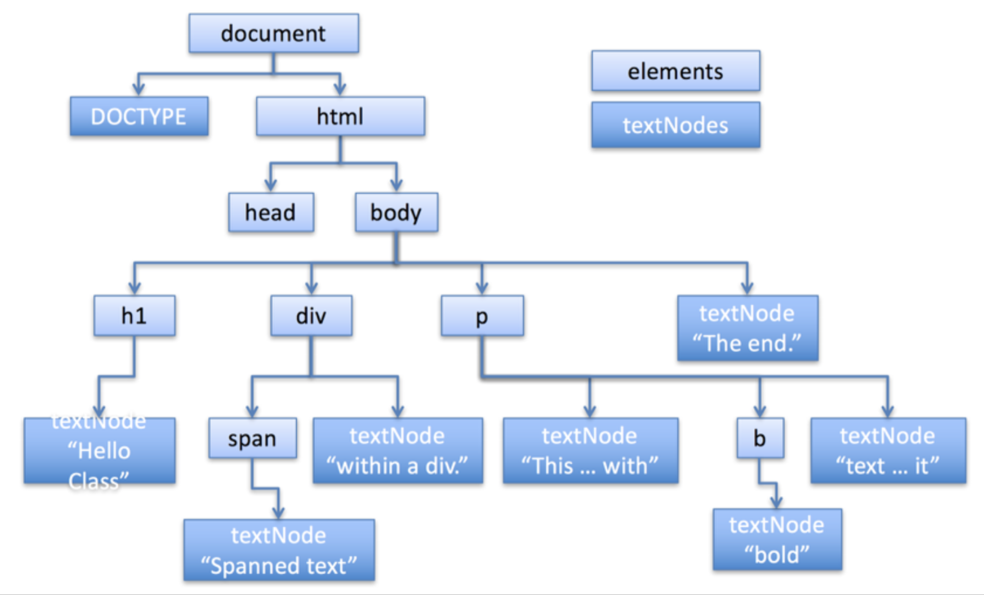
Document Object Model

Slide 20
Walking the DOM
document.body.childNodes[1]
document.body.firstChild
document.body.firstChild.nextSibling
document.body.firstElementChild
document.body.firstElementChild.innerHTML
document.body.firstElementChild.nodeName
document.body.firstElementChild.id
hw.nodeName
hw.nextElementSibling

Slide 21
Searching the DOM
document.getElementById("pp1").innerHTML
"This is a paragraph with <b>bold</b> and <span id=“span1">spanned </span> text within it”
document.getElementsByName("2nd")
[<span id=“span2” name=“2nd”>spanned </span>]
Notice the plural Elements and that an array is returned (Even if only for one element)
document.getElementsByTagName("span")
[<span id="span1">Spanned text</span>,
<span id="span2" name="2nd">spanned </span>]

Slide 22
Creating Elements
Create a new element:
de=document.createElement(“p”);
Create a textNode
tn=document.createTextNode(“It is 11:30am.”);
Add the textNode to the <p> element
de.appendChild(tn);
Insert a node before another
tn=document.createTextNode(“What time is it? ”);
de.insertBefore(tn, de.firstChild);
Add the whole thing to the document
var dv=document.getElementsByTagName("div");
document.body.insertBefore(de,dv[0]);

